Slide 1







Single-variate Linear Regression
21010469 김민경

Slide 2

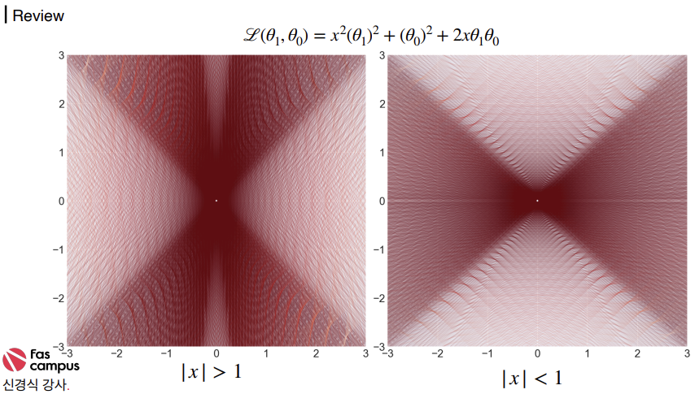

Learning with One Sample
02

Slide 3
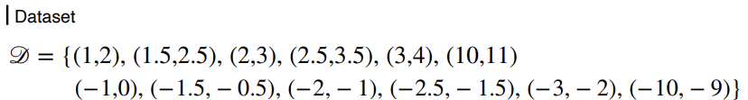
Learning with One Sample
03

Slide 4
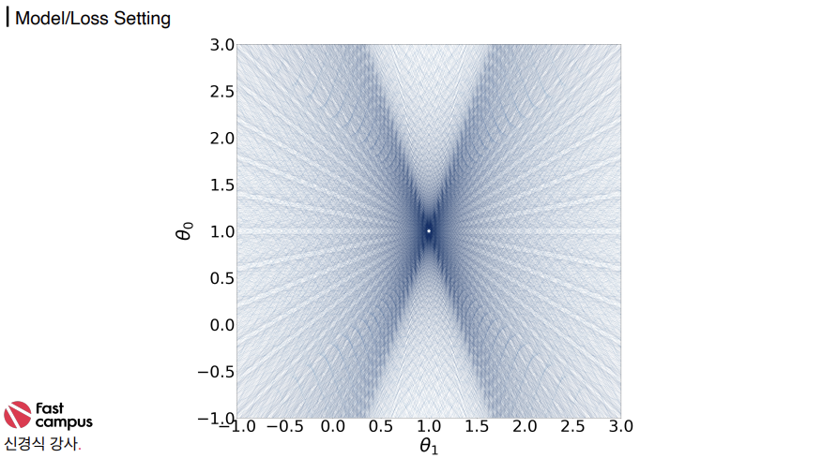

Learning with One Sample
04

Slide 5
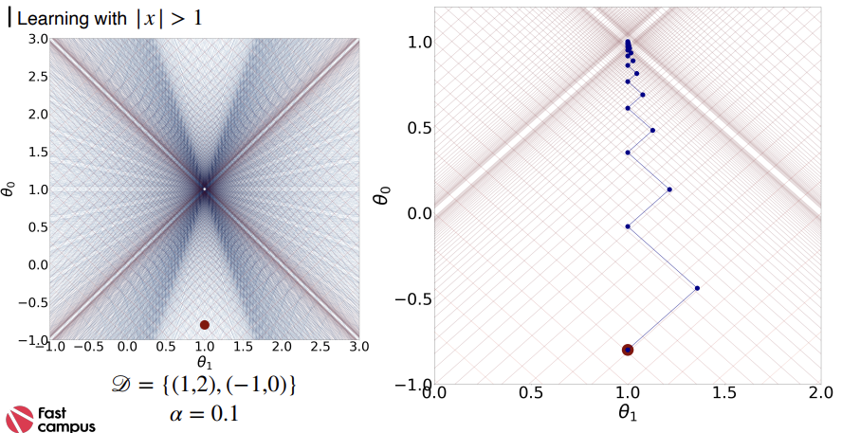
Learning with One Sample
05

Slide 6
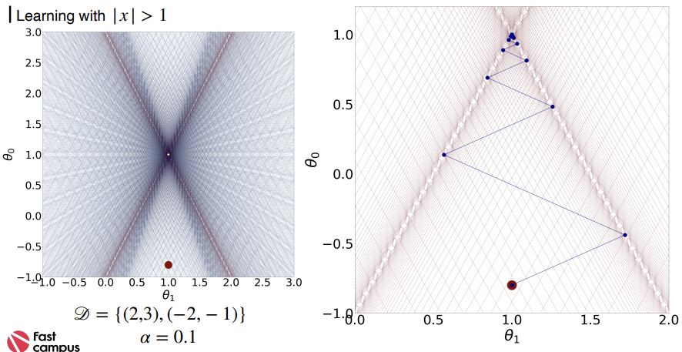
Learning with One Sample
06

Slide 7
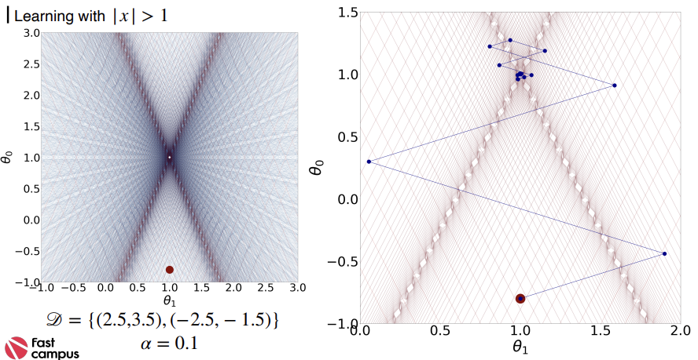
Learning with One Sample
07

Slide 8
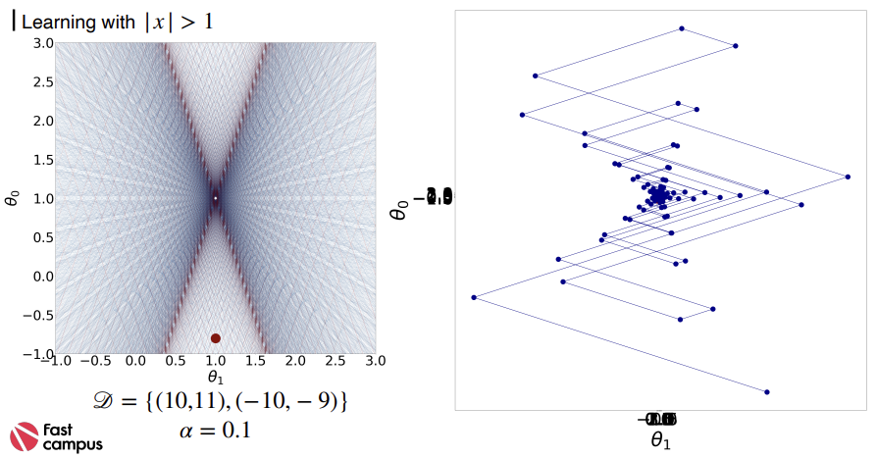
Learning with One Sample
08

Slide 9
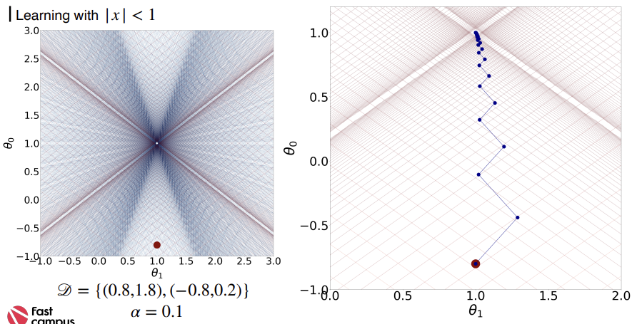
Learning with One Sample
09

Slide 10
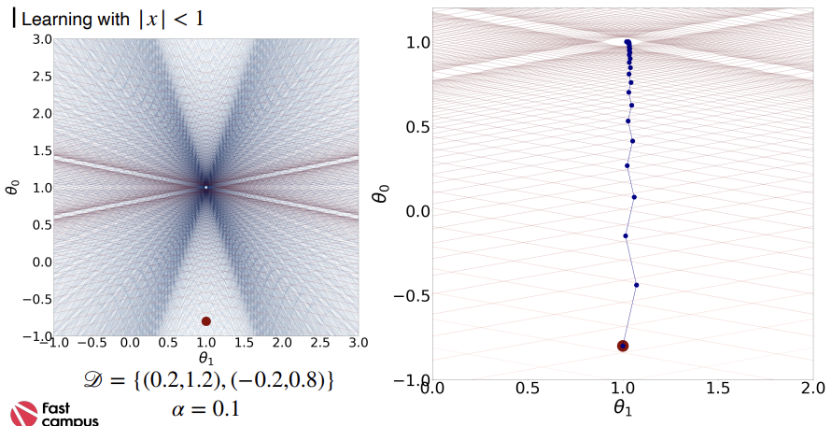
Learning with One Sample
10

Slide 11
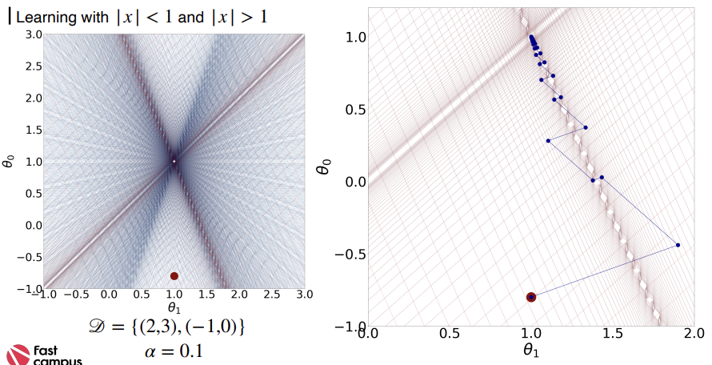
Learning with One Sample
11

Slide 12
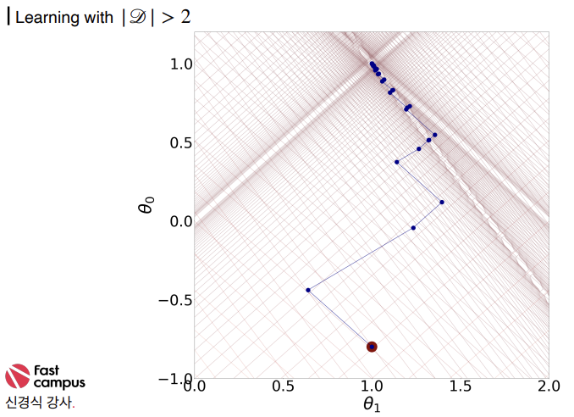
Learning with One Sample
12

Slide 13
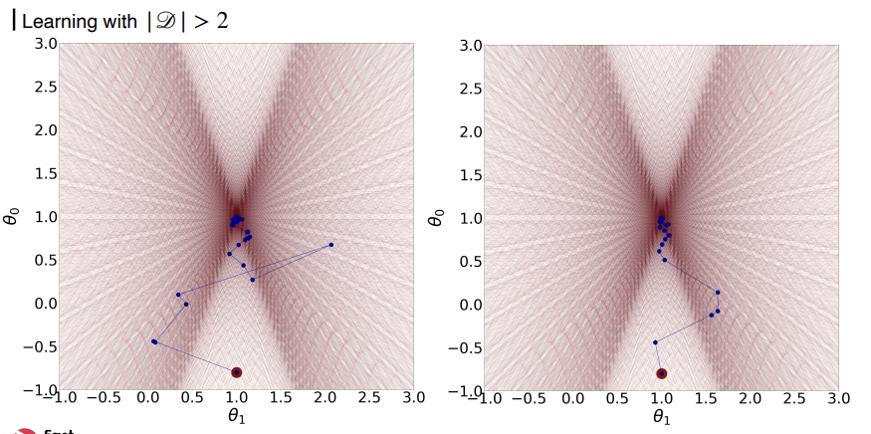
Learning with One Sample
13

Slide 14
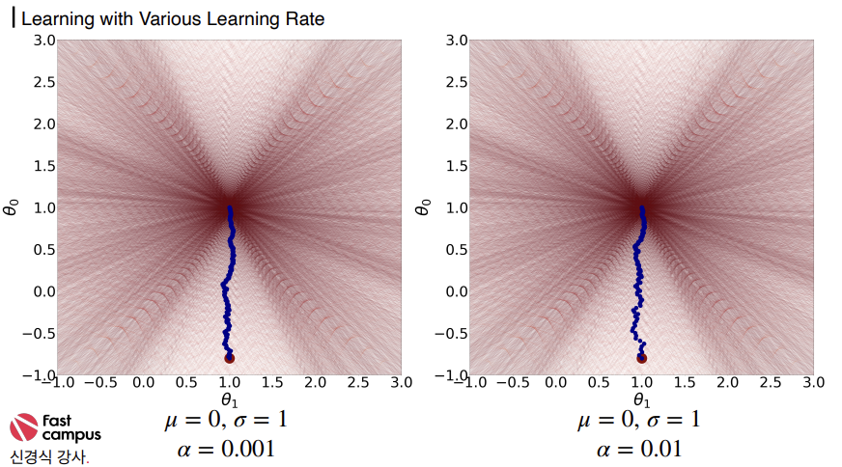
Learning with One Sample
14

Slide 15

Learning with One Sample
15

Slide 16
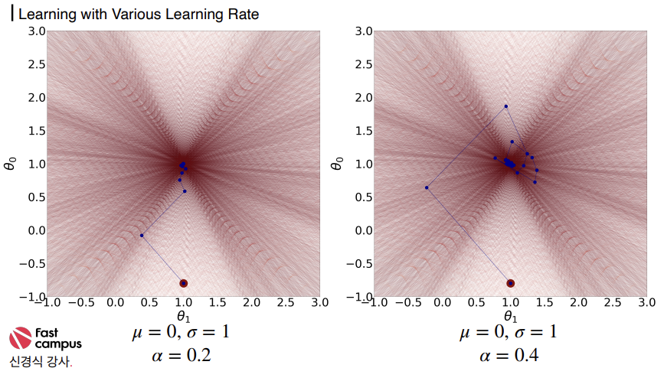
Learning with One Sample
16

Slide 17
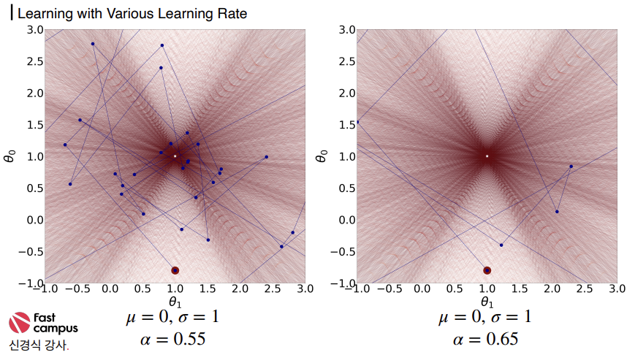
Learning with One Sample
17

Slide 18
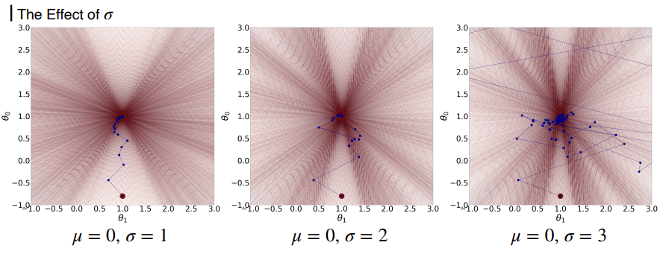
Learning with One Sample
18

Slide 19
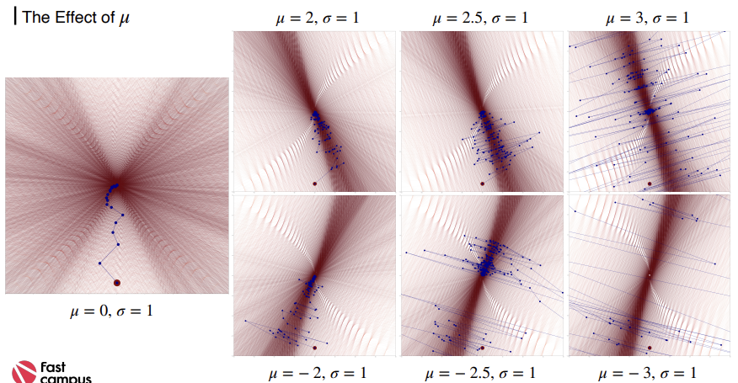
Learning with One Sample
19

Slide 20
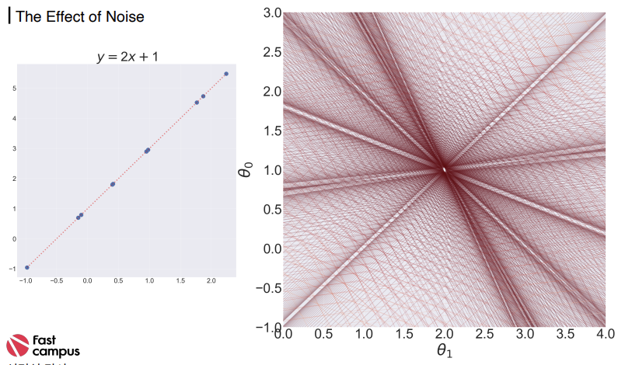
Learning with One Sample
20

Slide 21
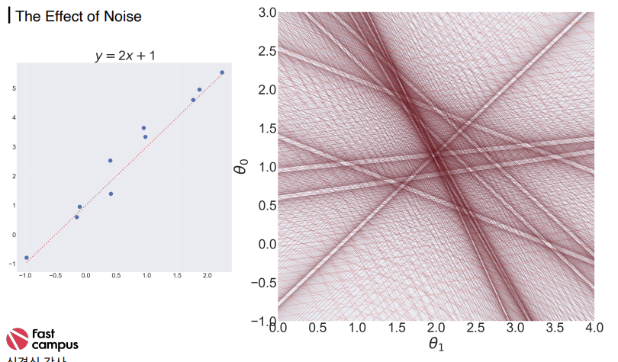
Learning with One Sample
21

Slide 22
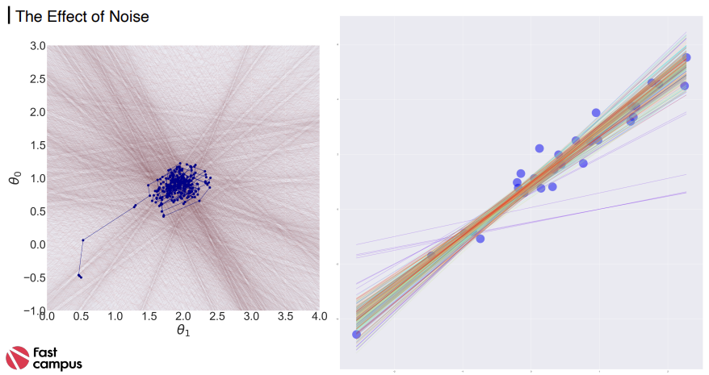
Learning with One Sample
22

Slide 23
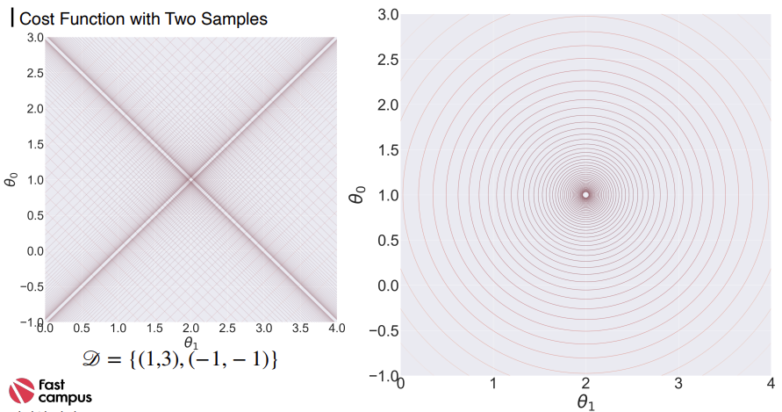
Cost Functions
23

Slide 24
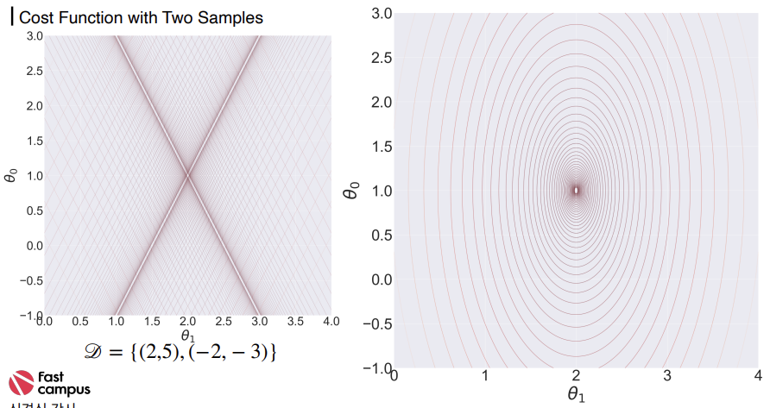
Cost Functions
24

Slide 25
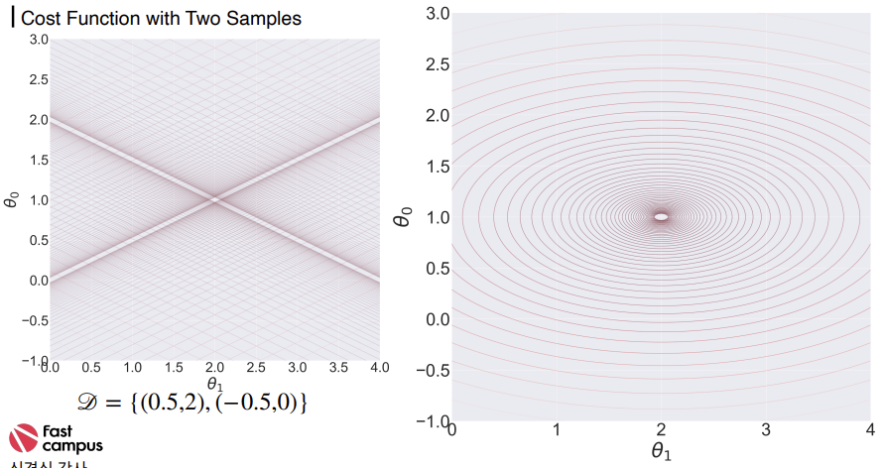
Cost Functions
25

Slide 26
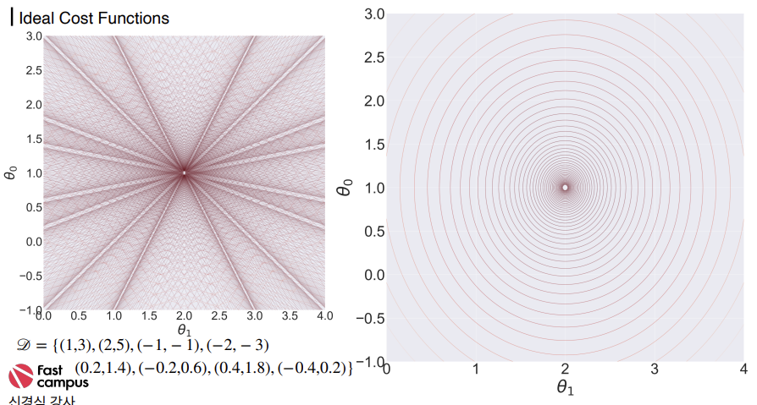
Cost Functions
26

Slide 27
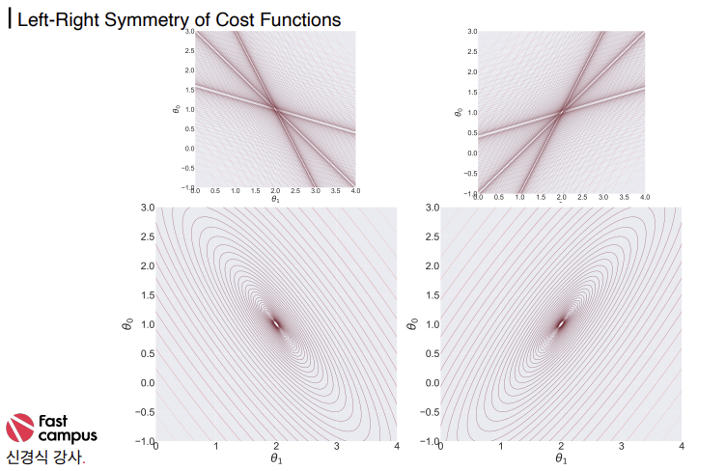
Cost Functions
27

Slide 28
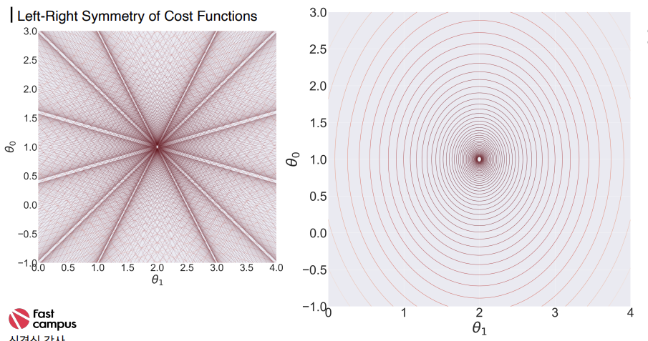
Cost Functions
28

Slide 29
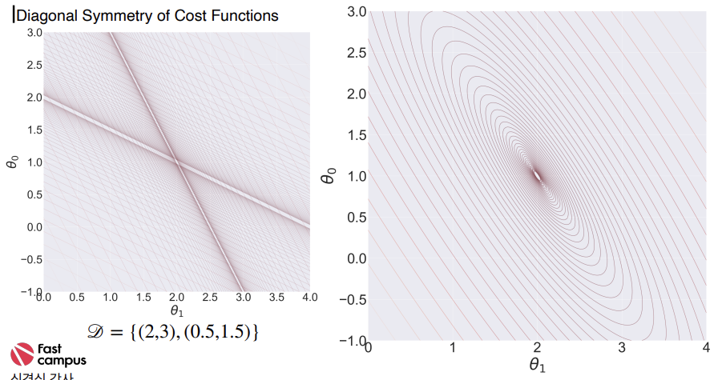
Cost Functions
29

Slide 30
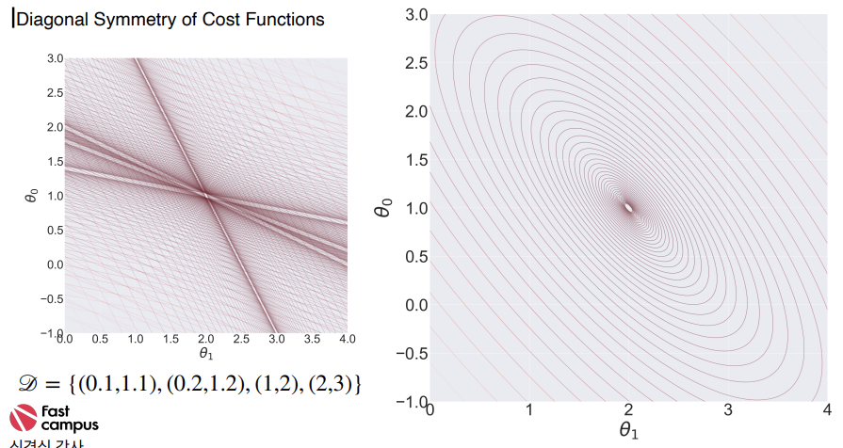
Cost Functions
30

Slide 31
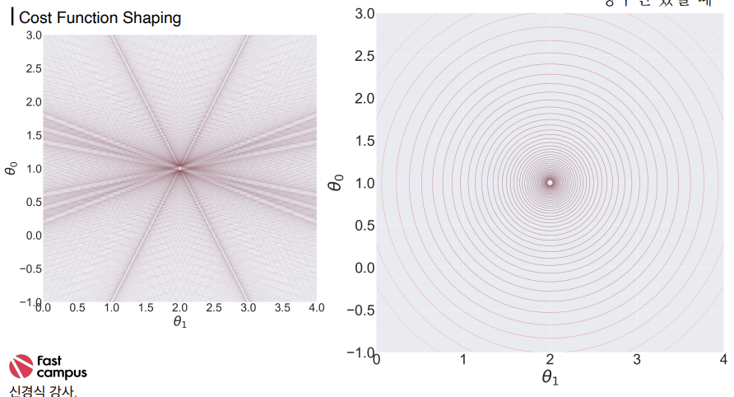
Cost Functions
31

Slide 32
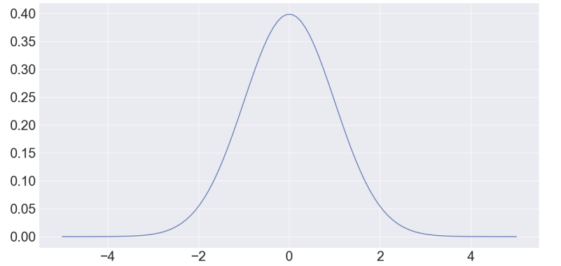
Cost Functions
32

Slide 33
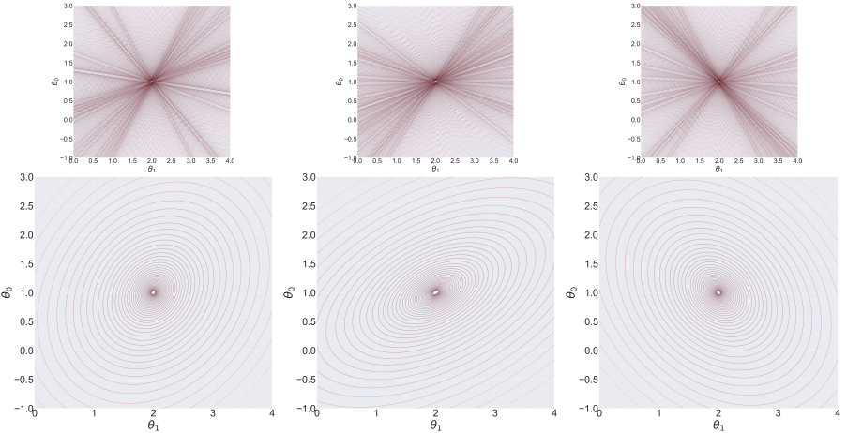
Cost Functions
33

Slide 34
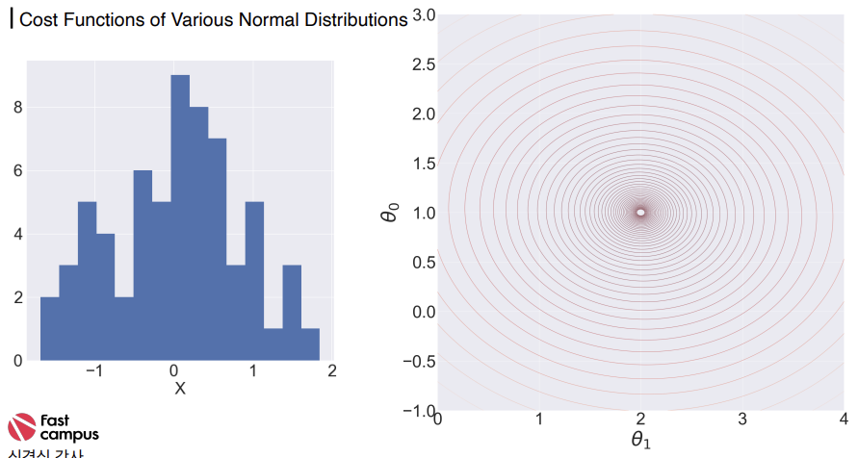
Cost Functions
34

Slide 35
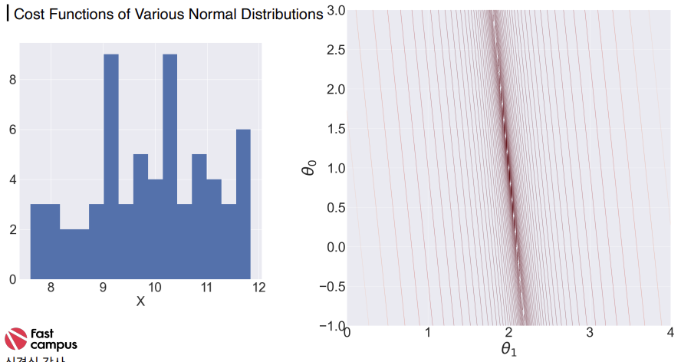
Cost Functions
35

Slide 36
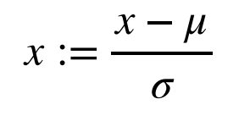
Feature Scaling
36

Slide 37
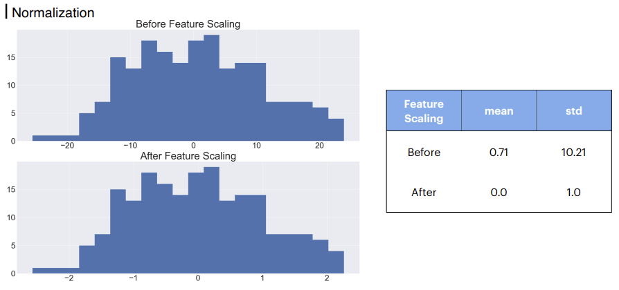
Feature Scaling
37

Slide 38
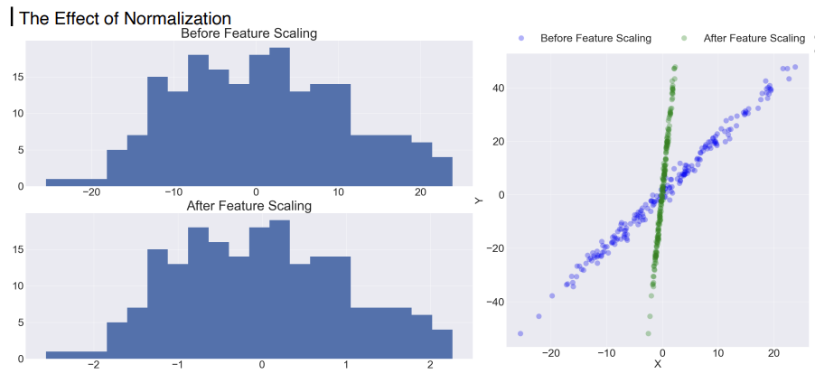
Feature Scaling
38

Slide 39
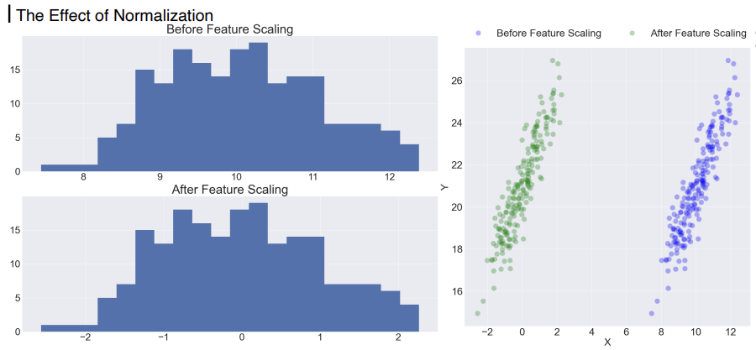
Feature Scaling
39

Slide 40
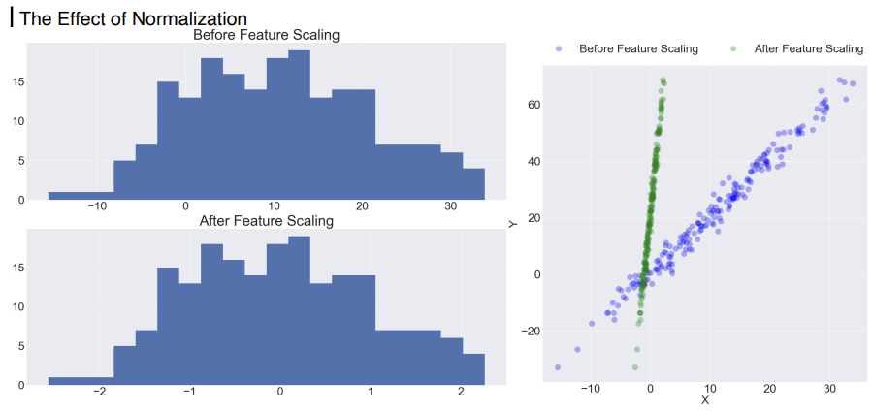
Feature Scaling
40

Slide 41
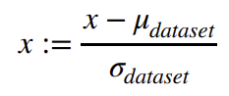
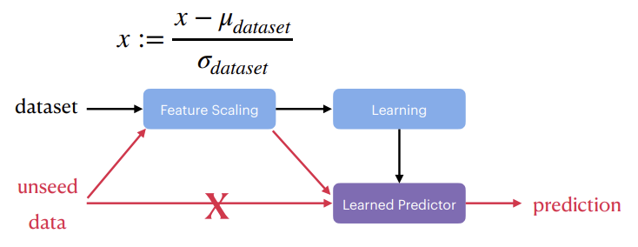
Feature Scaling
41

Slide 42
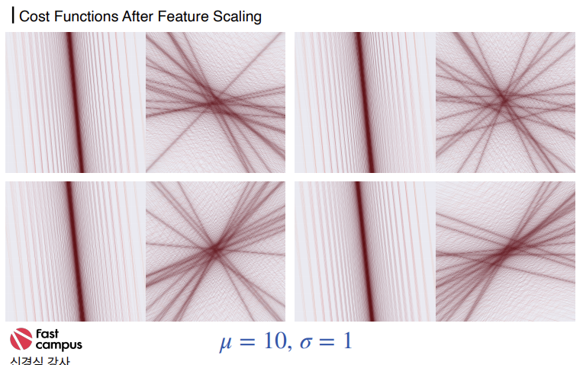
Feature Scaling
42

Slide 43
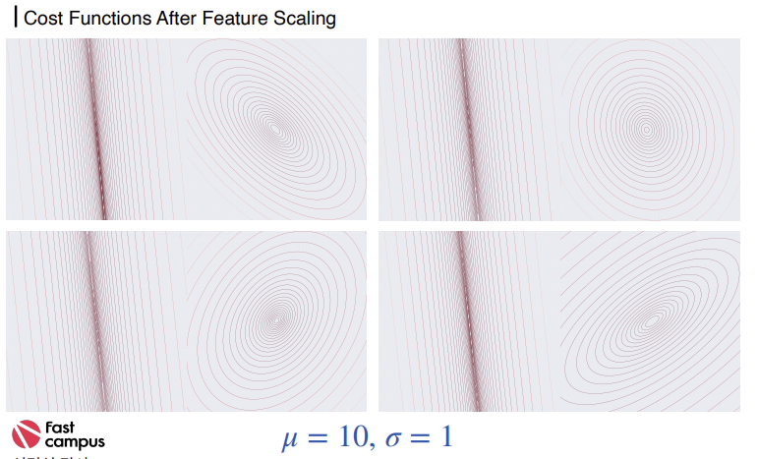
Feature Scaling
43

Slide 44
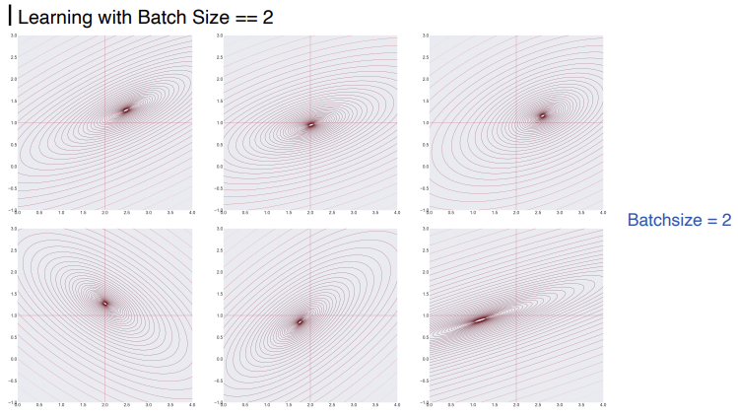
Learning with Mini-batch
44

Slide 45
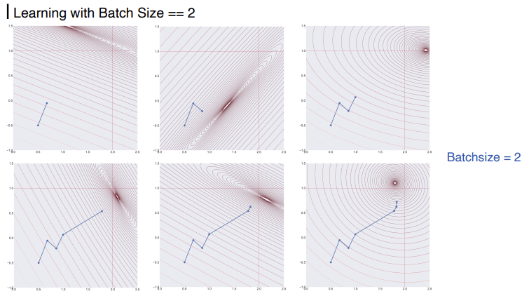
Learning with Mini-batch
45

Slide 46
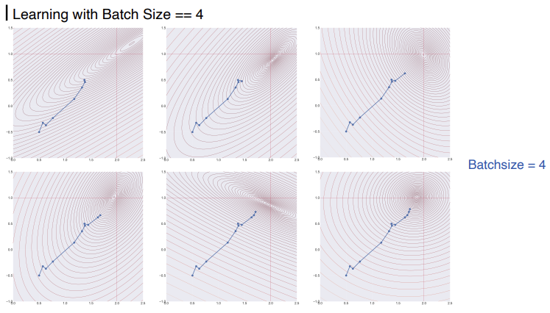
Learning with Mini-batch
46

Slide 47
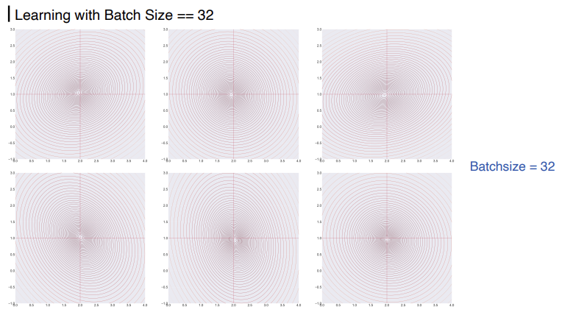
Learning with Mini-batch
47

Slide 48
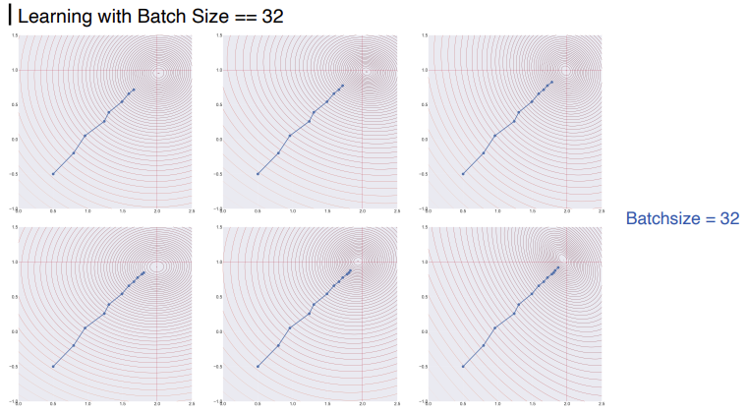
Learning with Mini-batch
48

Slide 49



THANKS FOR WATCHING

